Slide 1
BANK NOTE ORIGINALITY VERIFICATION USING DEEP NEURAL NETWORK CLASSIFIER VS RANDOM FOREST

Slide 2
Agenda
Introduction
Literature Review
Problem Statement
Research Question(s)
Research Objective(s)
Proposed Methodology
References

Slide 3
Introduction
One of the primary methods for exchanging goods and services is still using paper money.
The detection of counterfeit banknotes, which are becoming more and more similar to the real thing and are challenging for non-experts to identify, is still a challenge.
However, because these equipment are frequently costly, the identification and retention of counterfeit banknotes falls on financial and governmental organizations, with little to no community involvement, [2].
On the other hand, there are machines for detecting counterfeit banknotes, [1].

Slide 4
Introduction
The primary issue with these kinds of approaches is their poor accuracy and limited ability to generalize to new samples.
Using machine learning algorithms on banknote photos, the denomination of paper money is identified. Machine learning is one of the most advanced methods for recognizing, deciphering, and examining extraordinarily composite files configurations and designs[7].

Slide 5
Machine learning
Machine learning is a field of study in artificial intelligence concerned with the development and study of statistical algorithms that can learn from data and generalize to unseen data, and thus perform tasks without explicit instructions.

Slide 6
Deep neural network
A deep neural network operates by simulating the way human brains process information. It consists of multiple layers of interconnected nodes (neurons), which transform input data through weighted connections.
The network takes in data (like images, text, or sounds), processes it layer by layer, and outputs classifications or predictions based on learned patterns. Each layer extracts increasingly complex features from the input, and the model is trained using a large dataset to minimize prediction errors through a method called back propagation.

Slide 7
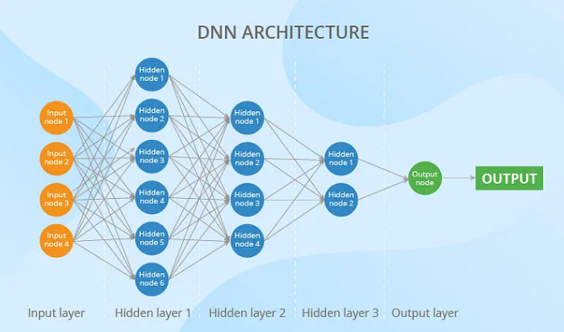
Deep neural network

Slide 8
Random Forest
Random Forest works by building multiple decision trees from random subsets of the training data and features. During training, it randomly selects samples and features to create diverse trees.
The final prediction is made by aggregating the predictions of all the trees, either through majority voting for classification tasks or averaging for regression tasks. This ensemble method helps improve accuracy and reduce over fitting.

Slide 9
Literature Review
Preserving the legitimacy of printed banknotes with larger values is one of the most crucial issues.
It is important to the financial operations of every country. For the purpose of this study, Aoba et al. identified Euro banknotes using multilayer perceptrons and RBF networks.
A variety of RBF kernels with various Euro denominations have been used by them, [3].

Slide 10
Literature Review
Zhou et al. used sampling procedures to assess the effectiveness of business bankruptcy prediction models on an unbalanced dataset [4].
Yu et al. employed Leave-One-Out incremental extreme machine learning and presented specific financial indicators to predict bankruptcy [5].
Guangli et al. estimated credit card churners using decision trees and logistic regression. They came to the conclusion that, for the actual Chinese bank dataset, LR outperforms decision trees [6].

Slide 11
Literature Review (Summary)
S. No. | Title of Research paper | Year | Problem Identified | Methodology Used | Results Achieved | Future Work
1 | Fake Banknote Recognition Using Deep Learning | 2021 | No comparison is performed between | Using sequential CNN and Transfer learning for bank note authentication | Comparison is performed.
2 | Ethiopian Banknote Recognition | 2022 | Ethiopian banknote recognition | Convolution neural network is used | A system is designed for Ethiopian banknote recognition
3 | DIAGNOSIS OF THE PARKINSON DISEASE BY USING DEEP NEURAL NETWORK CLASSIFIER, | 2017 | Parkinson disease prediction | Deep neural network is used | Parkinson disease is predicted
4 | Bank note authentication using Decision tree |  | Bank note authentication. | Decision tree | Bank note recognized

Slide 12
Problem Statement
The sophistication of banknote counterfeiting has increased recently due to technological improvements. Banks and other financial organizations are searching for reliable automated solutions that can swiftly and precisely authenticate banknotes in order to counter this.
The goal is to create a machine learning model that, using predetermined characteristics, can accurately identify between real and fake banknotes.
A collection of features taken from pictures of real and fake banknotes are included in the dataset. The banknote pictures' variance, skewness, curtosis, and entropy are some of these characteristics. The objective is to create a classification model that can accurately determine if a banknote is genuine or counterfeit based on a set of attributes.

Slide 13
Research Question(s)
Q1: How effective are deep neural networks and Random forest in authenticating bank notes?
Q2: How does the accuracy and reliability of deep neural networks for bank note authentication compare with Random forest ?

Slide 14
Research Objective(s)
The objectives of banknote authentication aim to ensure the reliability and safety of economic trades by verifying the authenticity of banknotes. Here are the key objectives:
Prevent Counterfeiting: The primary objective is to detect counterfeit banknotes to prevent financial losses and maintain trust in the currency system.
Ensure Trust and Confidence: By reliably authenticating banknotes, financial institutions uphold trust and confidence among customers and stakeholders in the currency's validity.
Enhance Consumer Protection: Protecting consumers and businesses from counterfeit currency ensures their financial interests are safeguarded, reducing potential losses due to fraud.
Educate the Public: Educating the public about counterfeit detection methods and the importance of using genuine currency helps reduce the circulation of counterfeit money.

Slide 15
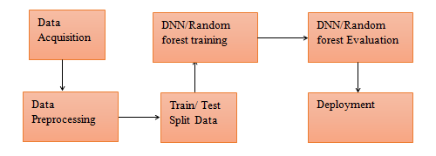
Proposed Methodology

Slide 16
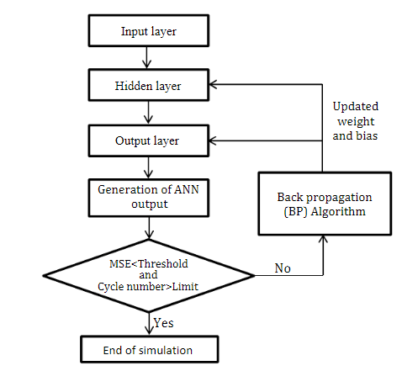
DNN

Slide 17
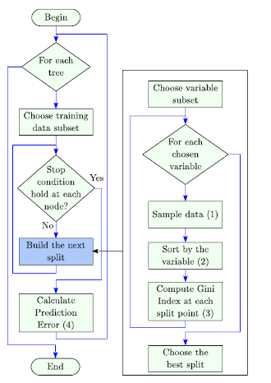
Random forest

Slide 18
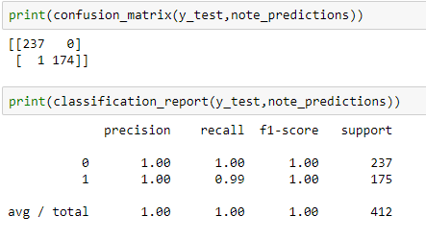
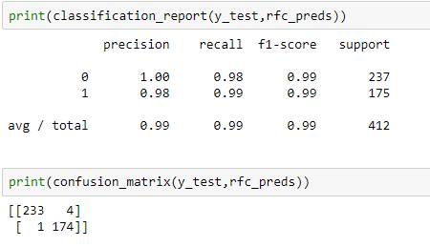
Results and Discussion
Deep neural network
Random forest

Slide 19
Comparative Analysis
DNN Outperforms RF in precision, recall, and F1-score for class 0, where it achieves perfect precision and recall. This means the DNN had no false positives (FP = 0) for class 0, whereas Random Forest had 4.
For class 1, both models perform similarly, with nearly identical metrics. However, DNN still slightly edges out Random Forest with a perfect F1-score of 1.00 compared to RF’s 0.99.
DNN had 1 false negative, while Random Forest had 4 false positives and 1 false negative.
The Deep Neural Network slightly outperforms Random Forest in the banknote authentication task, particularly in handling class 0, where it makes no errors, compared to 4 false positives from the Random Forest model. Both models perform exceptionally well overall, but DNN shows a marginal advantage in precision and F1-score, indicating its superiority in this task.

Slide 20
Conclusion
For banknote authentication, the choice between DNNs and Random Forest depends on the complexity of the task and the availability of data. DNNs are suitable when high accuracy and the ability to learn intricate patterns from raw data are crucial, provided there is sufficient data and computational resources. Random Forest offer transparency, interpretability, and robustness, making them suitable when feature engineering and model interpretability are priorities.
In practice, hybrid approaches that combine the strengths of both DNNs (for feature learning) and Random Forest (for ensemble prediction and interpretability) could potentially offer a balanced solution, leveraging the advantages of each method depending on specific aspects of banknote authentication tasks.

Slide 21
References
[1]: Lundblad, L.J.; Vedin, L.; Bjorkman, C. Method for a Banknote Detector Device, and a Banknote Detector Device. US Patent 8,942,461, 27 January 2015.
[2]. Lee, S.H.; Lee, H.Y. Counterfeit Bill Detection Algorithm using Deep Learning. Int. J. Appl. Eng. Res. 2018, 13, 304–310.
[3] M. Aoba, T. Kikuchi, Y. Takefuzi, Euro banknote recognition system using a three layered perceptron and rbf networks, IPSJ Transactions on mathematical modelling and its applications, vol.44 (may 2003) No. SIG 7(TOM 8).Machine learning and cybernetics, 2260-2264.
[4] Ligang Zhou, Performance of corporate bankruptcy prediction models on imbalanced dataset: The effect of sampling methods, Knowledge- Based Systems 41 (2013) 16-25.
[5] Qi Yu, YoanMiche, Eric Severin, AmauryLendasse, Bankruptcy prediction using extreme learning machine and financial expertise, Neurocomputing 128 (2014) 296-302.
[6] GuangliNie, Wei Rowe, Lingling Zhang, YingjieTian, Yong Shi, Credit card churn forecasting by logistic regression and decision tree, Expert System with Application 38 (2011) 15273-15285.
[7] D. Aseffa, T., Kalla, & H. Mishra, Ethiopian banknote recognition using convolutional neural network and its prototype development using embedded platform. Journal of Sensors, 2022(1), 4505089.

Slide 22
Thank You
Q&A

